Slide 1
Keyboarding Position
Mrs. McCallie
Sitting properly when using a keyboard is very important!

Slide 2
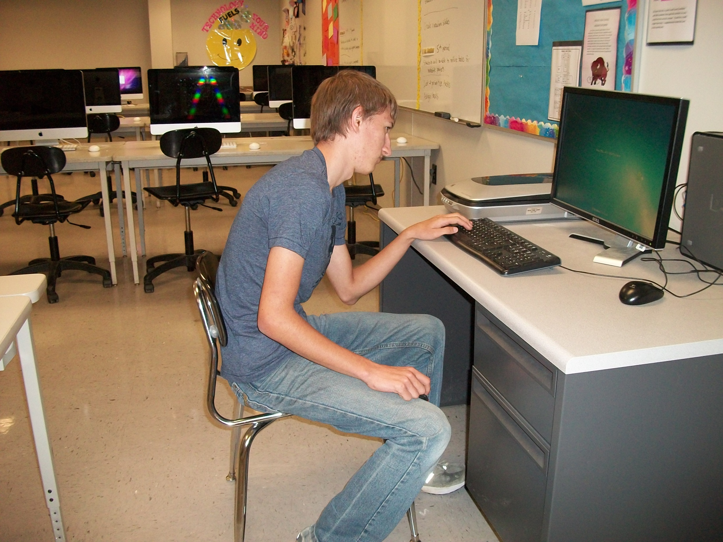
Incorrect Keyboarding Position

Slide 3
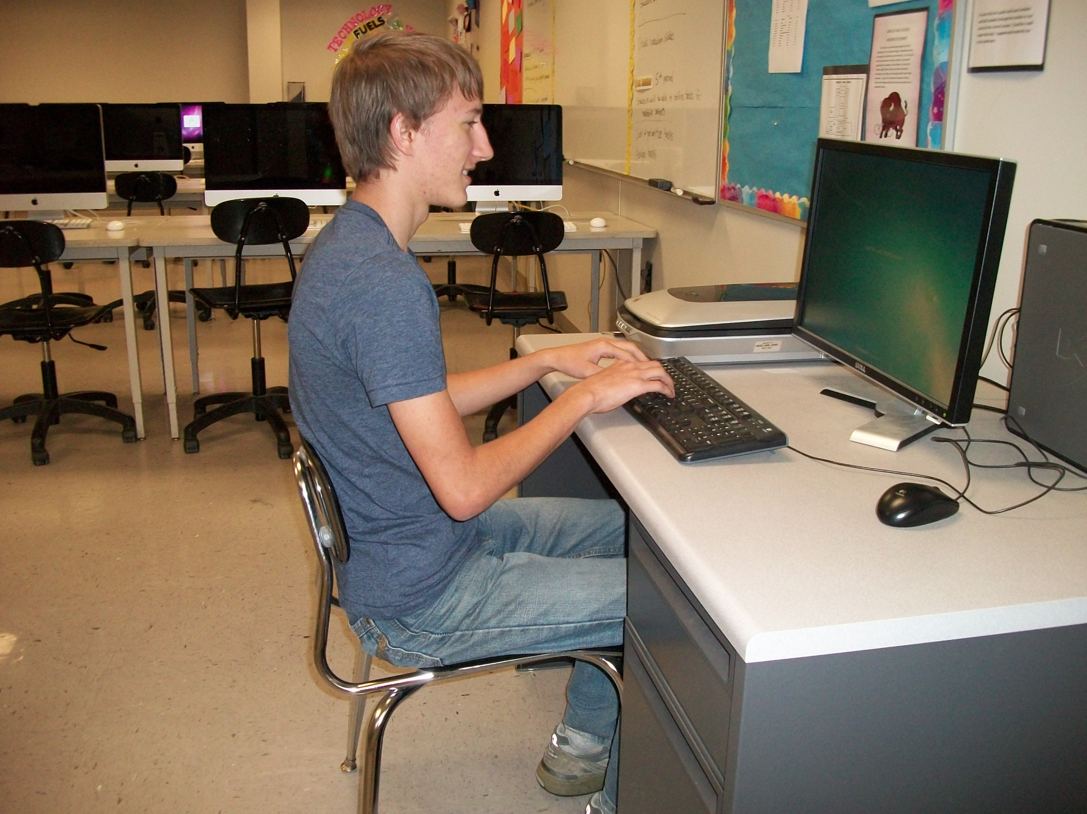
Correct Keyboarding Position

Slide 4
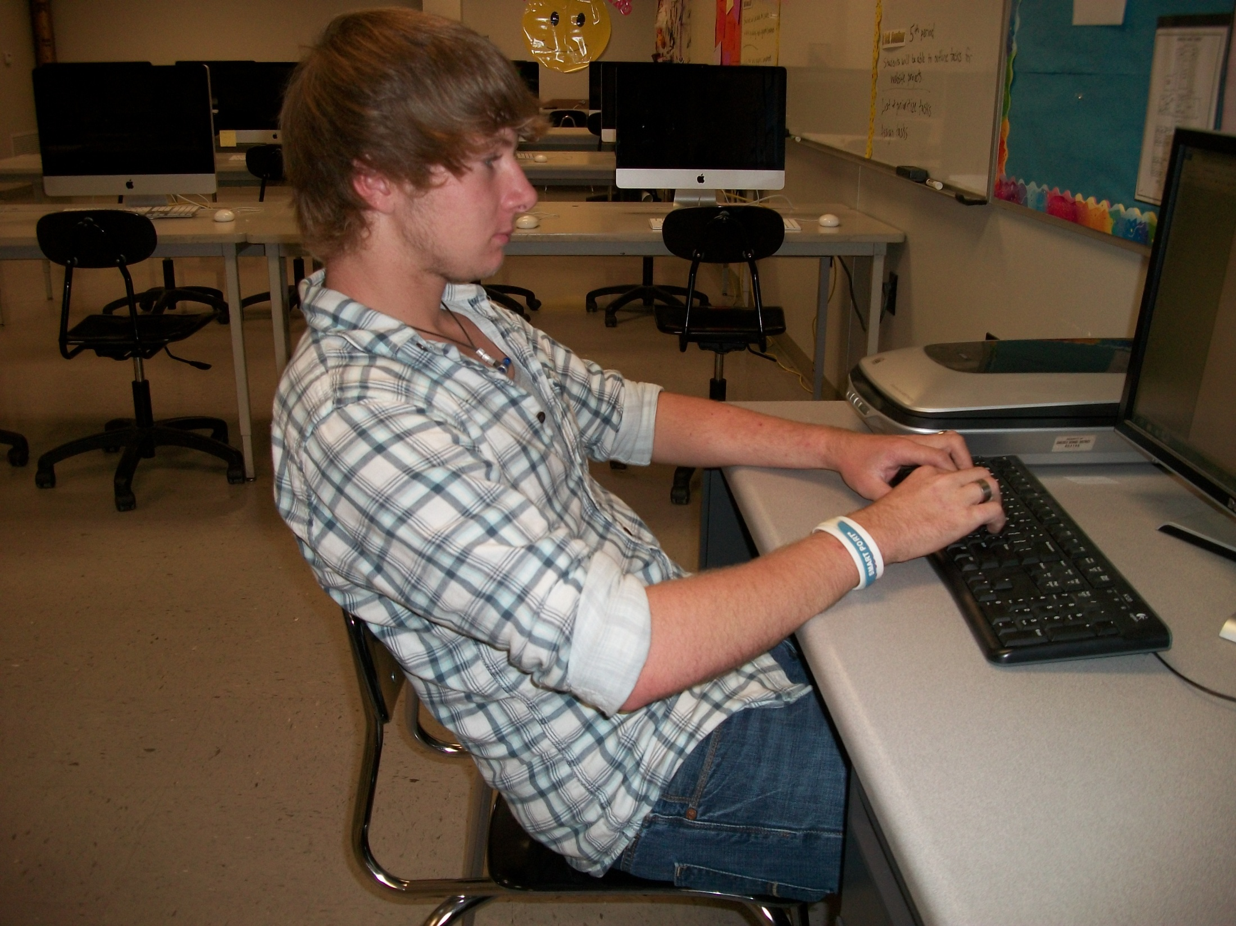
Incorrect
Body
Position

Slide 5
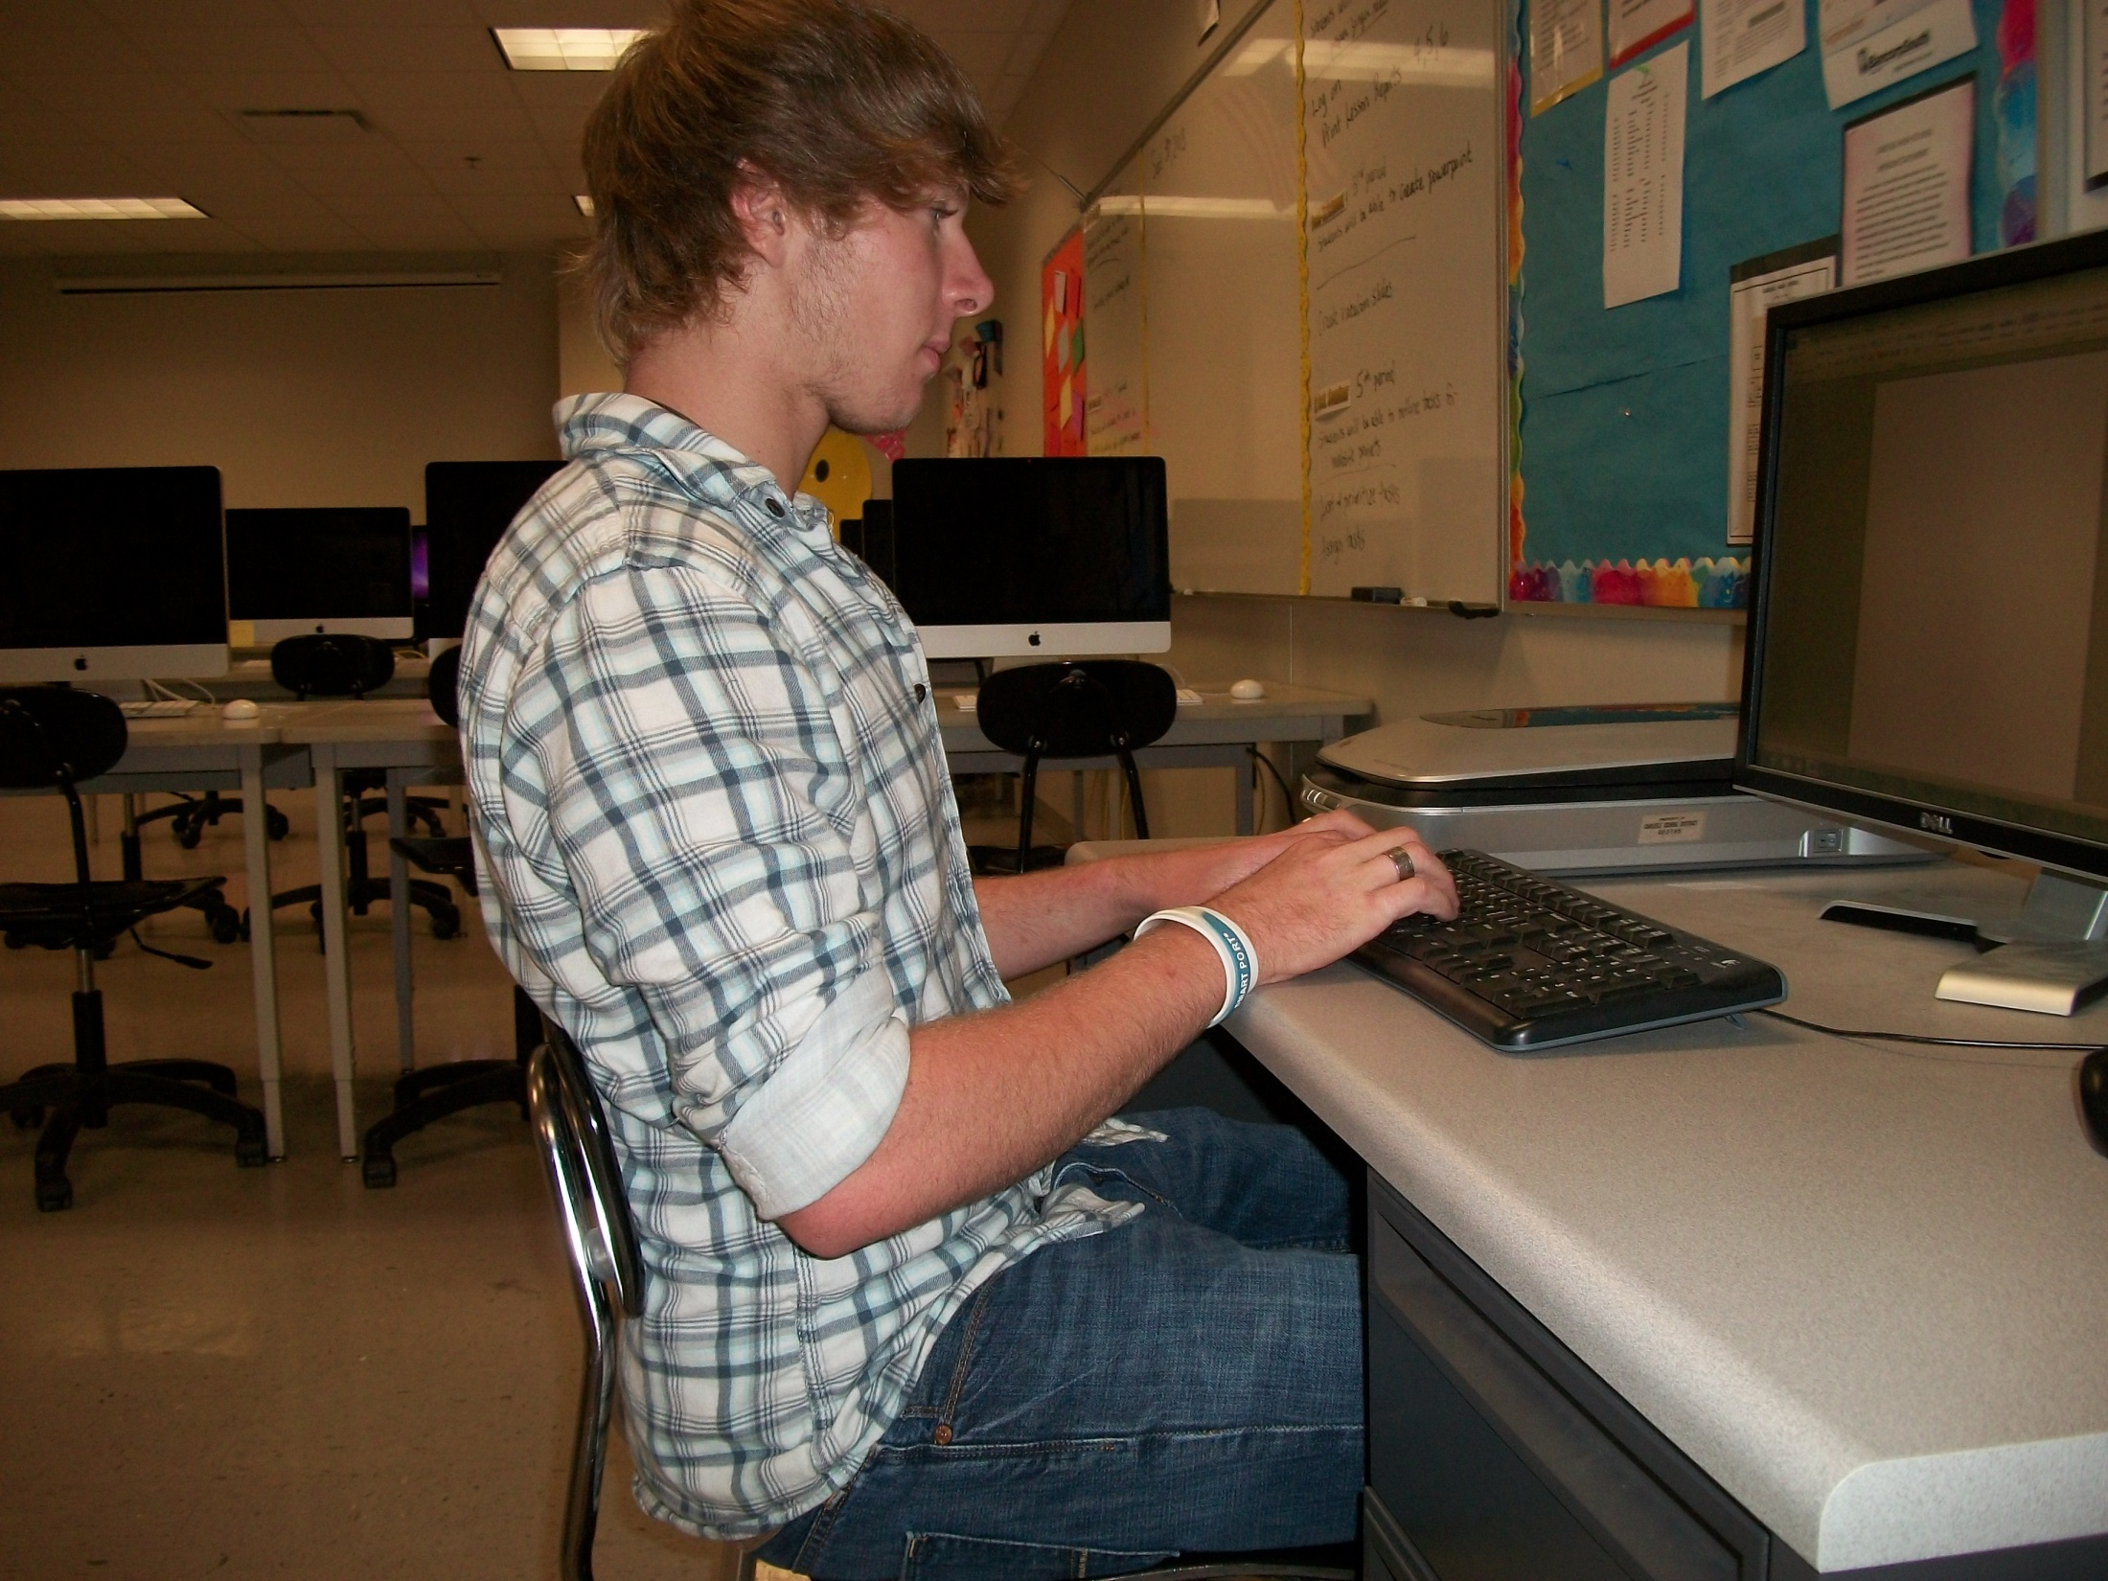
Correct Body Erect
Sitting Back in Chair

Slide 6
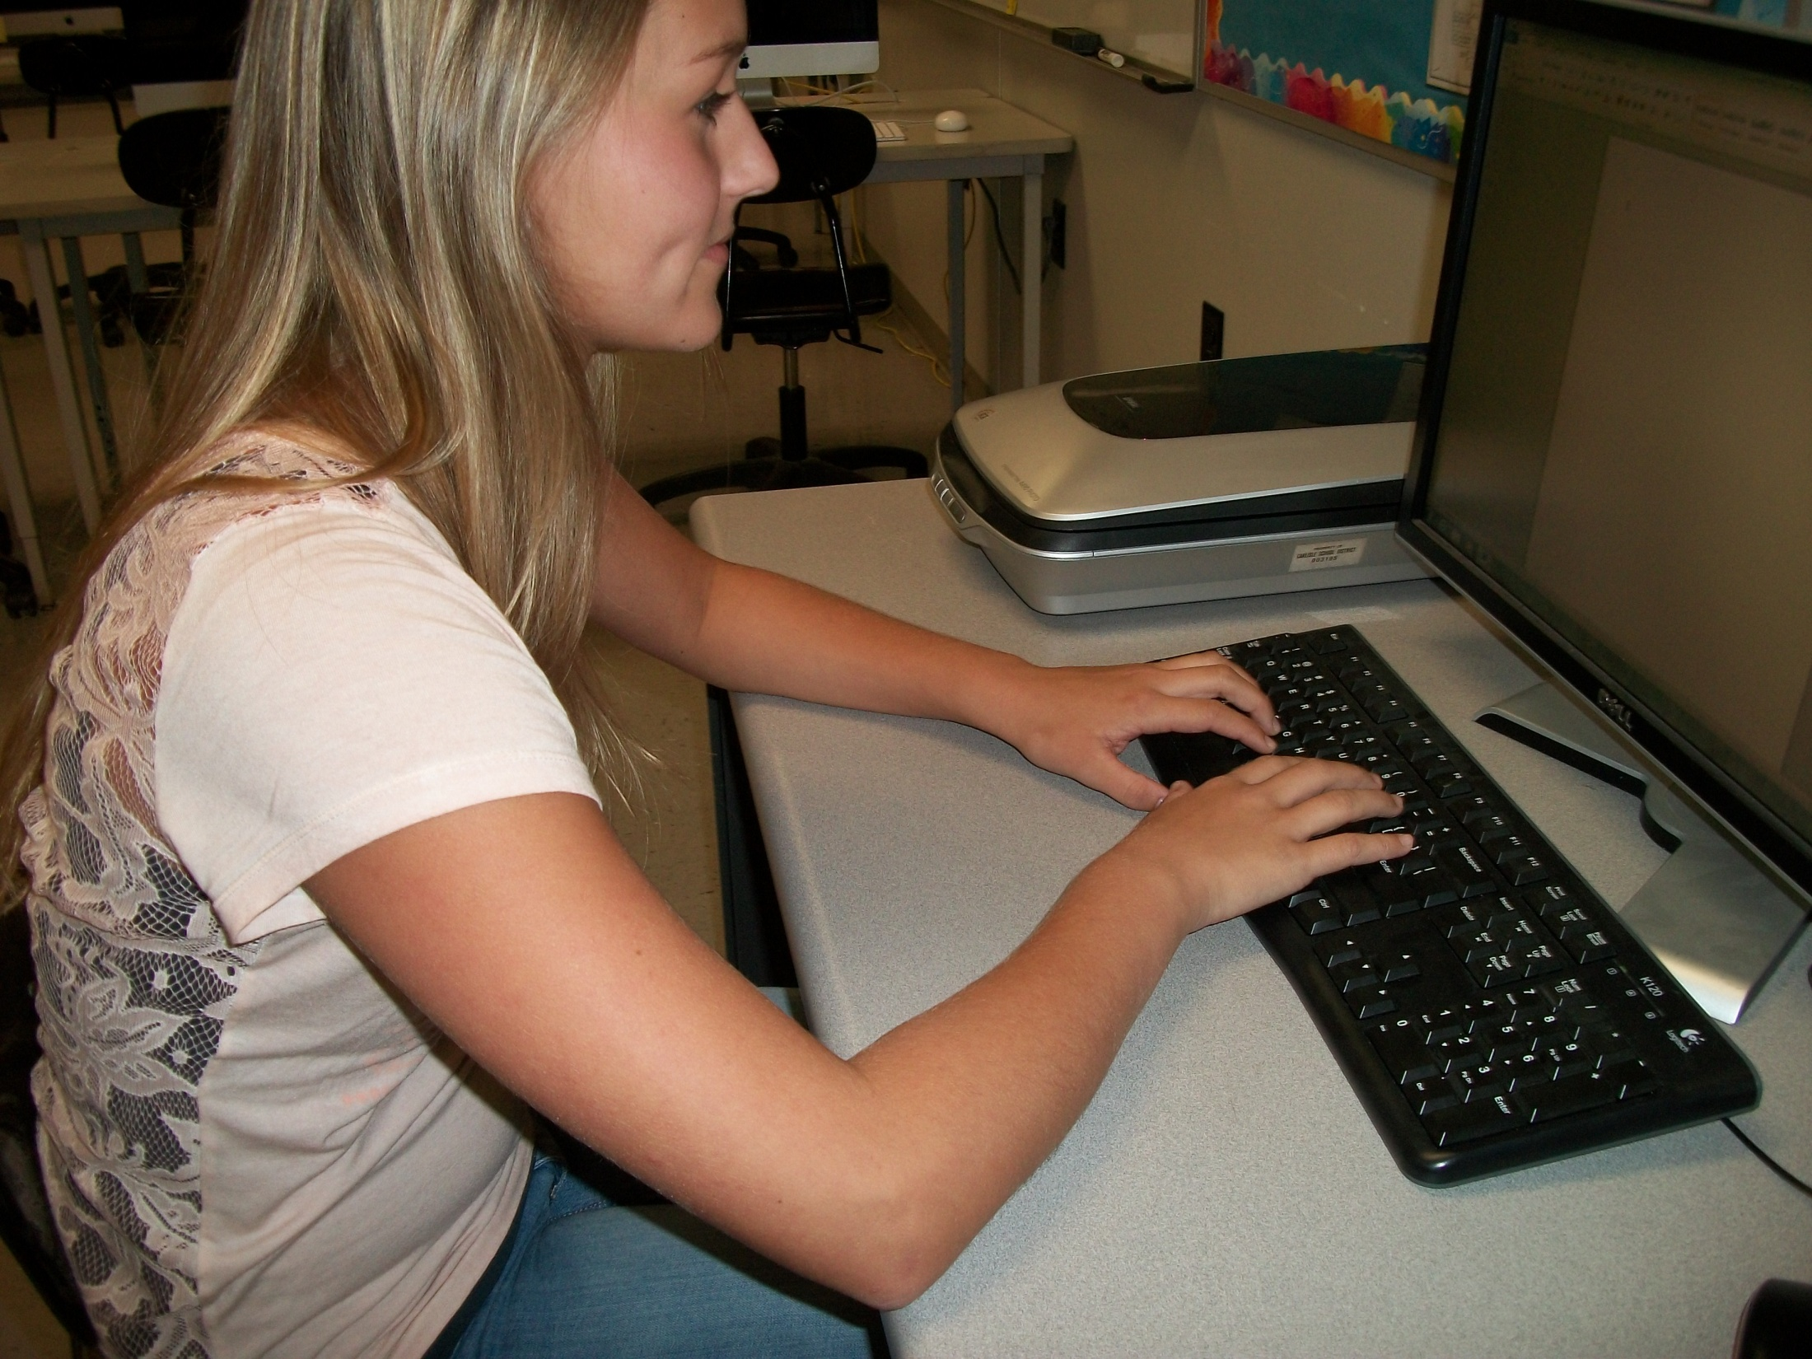
Incorrect
Arms
Position

Slide 7
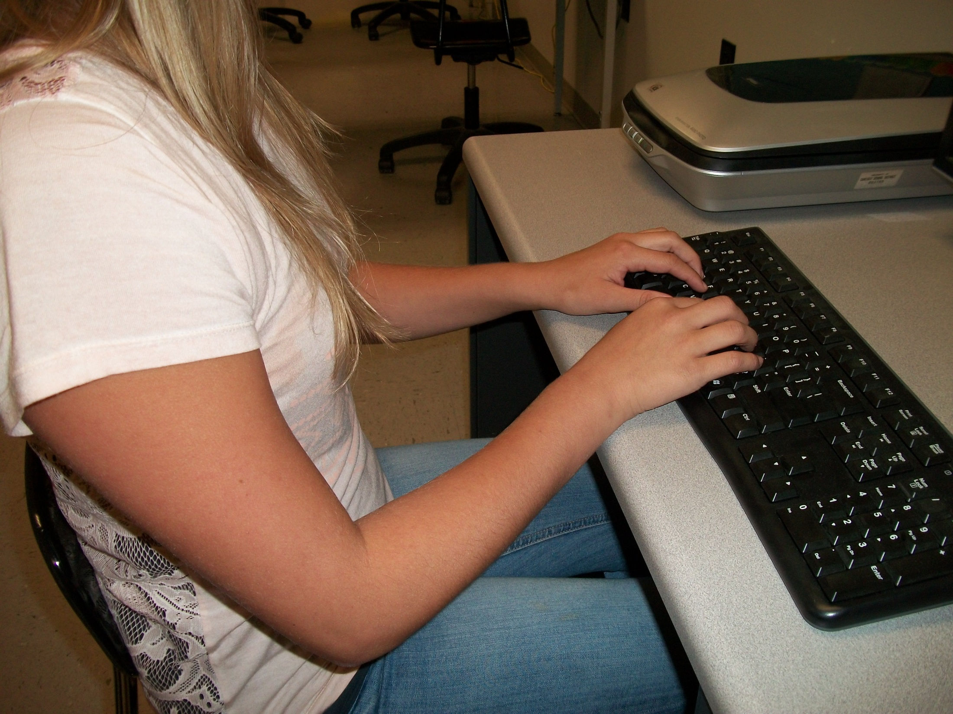
Correct
Arms Parallel to Slant of Keyboard

Slide 8
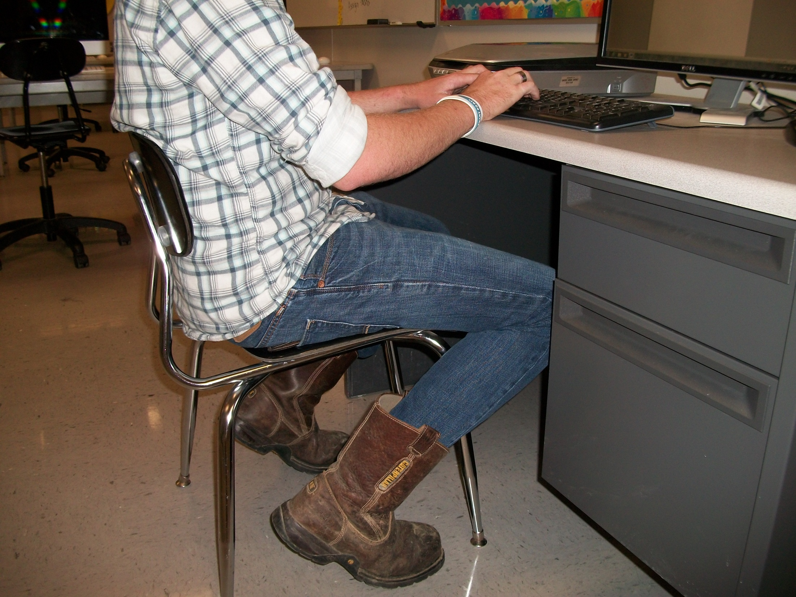
Incorrect Feet
Position

Slide 9
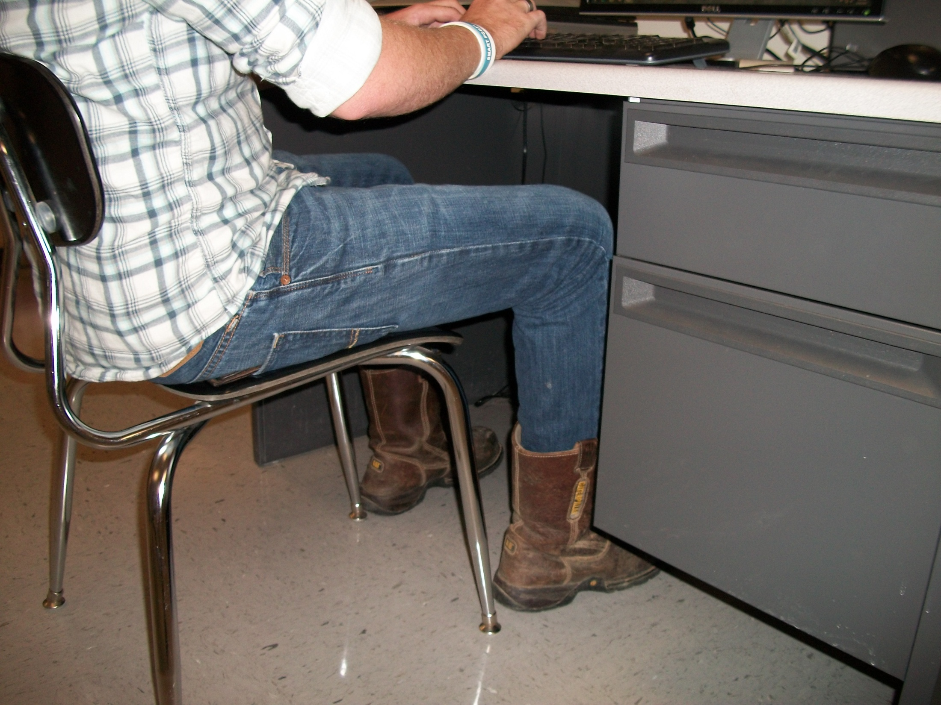
Correct
Feet on Floor

Slide 10

Incorrect Hand/Finger
Position

Slide 11

Correct Fingers curved over home keys

Slide 12
Proper keyboarding position allows you to type more accurately and quickly without straining your body!
Trust Me!
Try It!

Slide 13
Acknowledgements
Images taken by Angela McCallie with permission of the following students:
Anya Peterson
Gary Reeves
Jacob Sullivan

